Slide 1
Analyzing the Results of the db5 Edge-Deletion Experiment
Maggie ONeil and Lauren Kelly
February 22nd, 2018
Dahlquist Lab Meeting

Slide 2
Each edge from db5 was systematically deleted and run through both GRNmap and Gephi
In some cases, when an edge was deleted, a node was also deleted to remove an isolated node
Results from GRNmap (parameter estimation, LSE:minLSE) and results from Gephi were compiled for comparison
Measures (LSE:minLSE, production rates, graph stats etc) were compared between the edge deletion networks and the intact db5 network

Slide 3
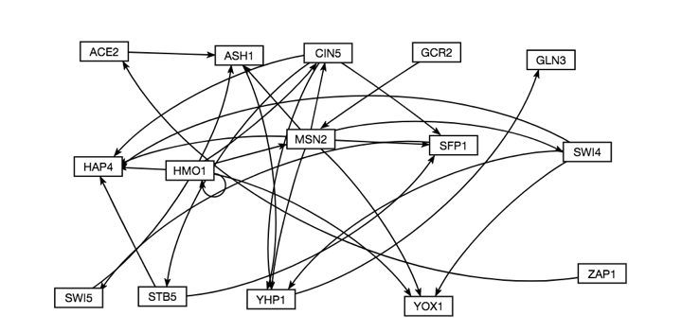

Slide 4
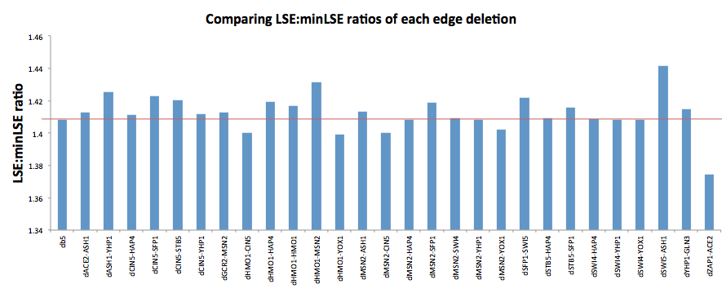
LSE:minLSE Ratios

Slide 5
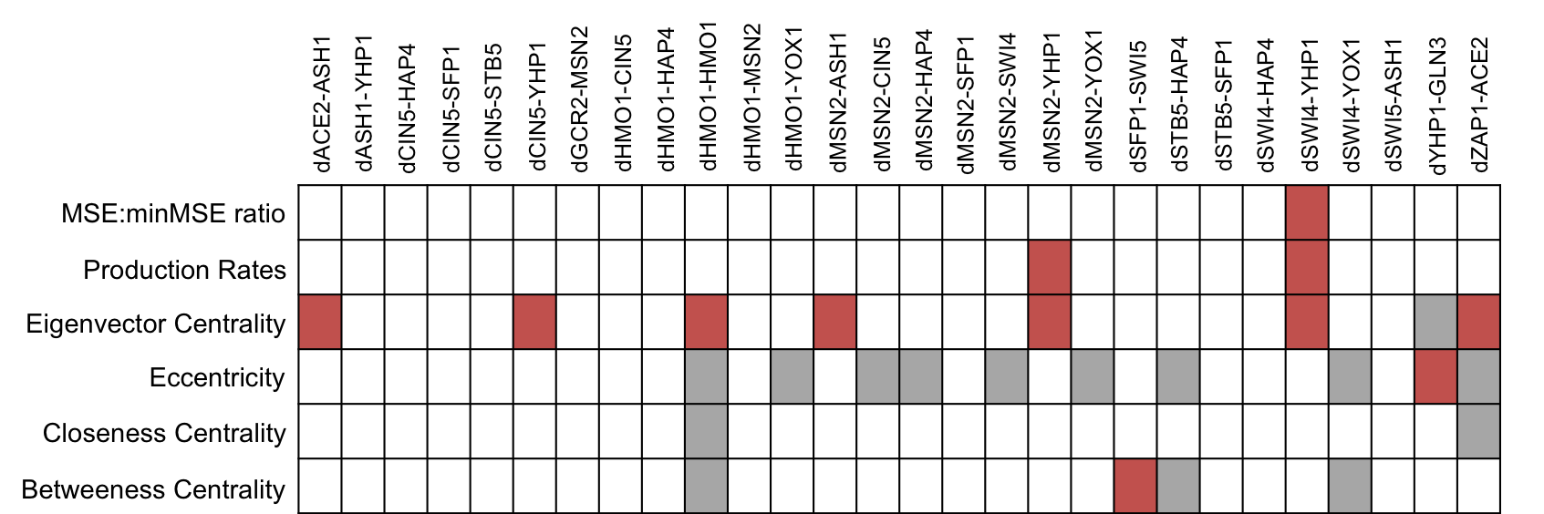
Paired t-tests show variance of measure between db5 and the edge deletion networks
Notes:
Red = significant
Grey = no change
Calculated MSE:minMSE ratio, only dSWI4-YHP1 was significantly different. This is likely an important edge because it’s deletion also produced significantly different production rates and eigenvector centrality

Slide 6
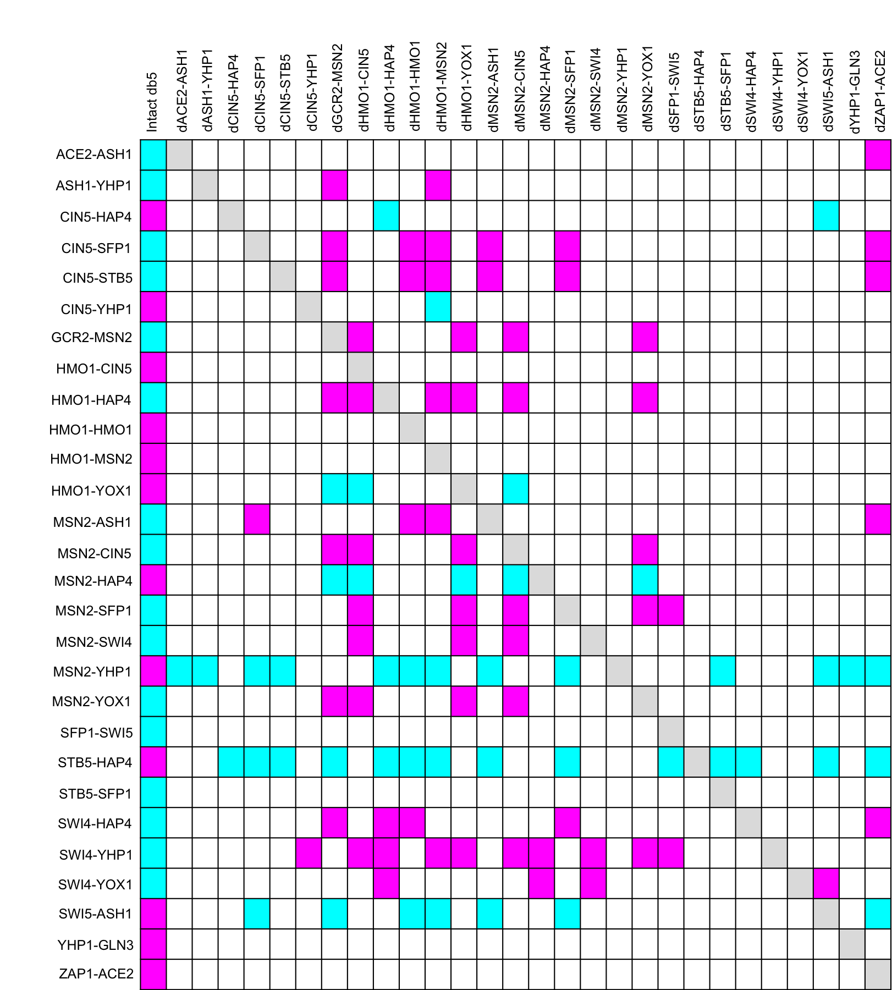
Most influential edges caused a lot of changes when deleted (dHMO1-MSN2)
Least stable edges are the edges with the most change (MSN2-YHP1 and STB5-HAP4)
Changes seem to be centralized in the deletions of edges with GCR2, HMO1, and MSN2
Notes:
Decided to look at changes in the upregulation or down regulation as a result of each deletion. The least stable edges are the one’s with the most change, like MSN2-YHP1 and STB5-HAP4
The most influential edges are the ones that caused a lot of changes when they were deleted, like dHMO1-MSN2. A lot of the changes that happen seem to be centralized in the deletions of edges with GCR2, HMO1, and some MSN2.

Slide 7
Overall findings
MSE:minMSE ratio only has significance in variance when SWI4-YHP1 is deleted
dSWI4-YHP1 had significant changes in MSE:minMSE ratio, production rates, and eigenvector centrality, but did not cause any change in regulation patterns.
Deletions of certain edges (e.g., dHMO1-MSN2) cause changes in the regulation patterns of the intact network
Centralized around deletions of edges with GCR2, HMO1, and MSN2
Most stable edges: HMO1-CIN5, HMO1-HMO1, HMO1-MSN2, SFP1-SWI5, STB5-SFP1, YHP1-GLN3, ZAP1-ACE2
Notes:
Closeness centrality has no significance in variance, and when HMO1-HMO1 was deleted there was no change
Eccentricity overall least impacted by edge deletions
Eigencentrality experienced the most significant changes as a result of the deletions
dHMO1-HMO1 overall does not appear to be a crucial part of the network

